Slide 1
Module 5: Configuring and Managing Virtual Networks

Slide 2
Importance
When you configure ESXi networking properly, virtual machines can communicate with other virtual, and physical, machines. In this way, remote host management and IP-based storage operate effectively.

Slide 3
Module Lessons
Introduction to vSphere Standard Switches
Configuring Standard Switch Policies

Slide 4
Virtual Beans: Networking Requirements
Virtual Beans has the following requirements for its network infrastructure:
Use the existing VLAN infrastructure and create VLANs as needed for the vSphere environment.
Use the available bandwidth efficiently:
Infrastructure services must get enough bandwidth.
Infrastructure traffic should not interfere with the performance of business-critical and nonbusiness-critical application traffic.
Avoid single points of failure.
As the Virtual Beans administrator, you must configure vSphere networking to meet these requirements.

Slide 5

Lesson 1: Introduction to vSphere Standard Switches

Slide 6
Learner Objectives
After completing this lesson, you should be able to meet the following objectives:
Identify virtual switch connection types
Configure and view standard switch configurations
Distinguish between the features of standard and distributed switches

Slide 7
About Virtual Switches
Virtual switches connect VMs to the physical network.
They provide connectivity between VMs on the same ESXi host or on different ESXi hosts.
They also support VMkernel services, such as vSphere vMotion migration, iSCSI, NFS, and access to the management network.

Slide 8
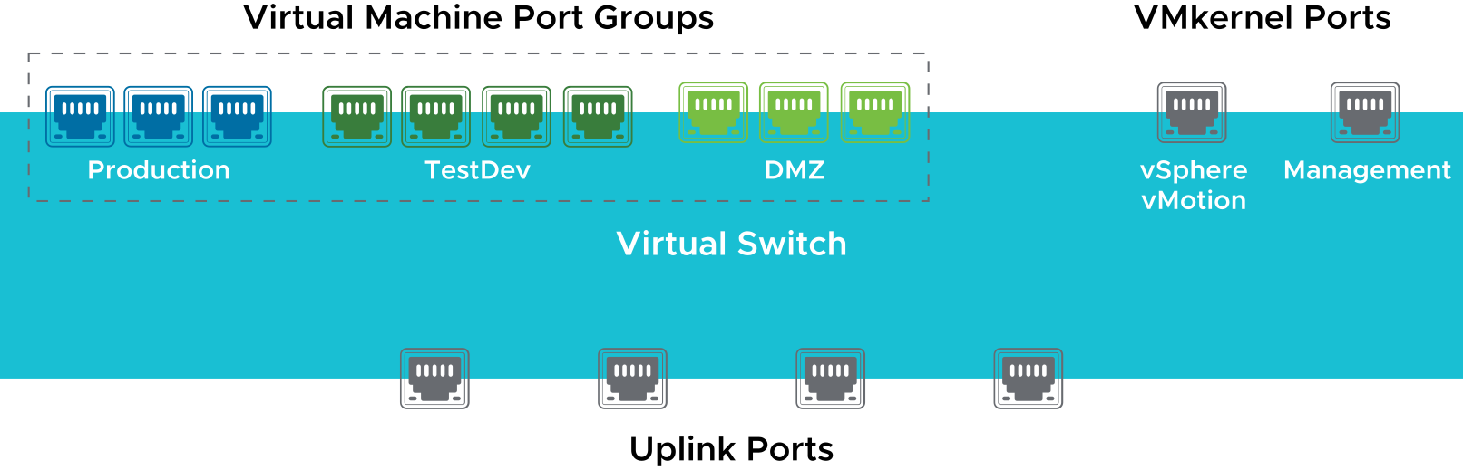
Types of Virtual Switch Connections
A virtual switch has specific connection types:
VM port groups
VMkernel port: For IP storage, vSphere vMotion migration, vSphere Fault Tolerance, vSAN, vSphere Replication, and the ESXi management network
Uplink ports
Notes:
The ESXi management network port is a VMkernel port that connects to network or remote services, including vpxd on vCenter Server and VMware Host Client. Each ESXi management network port and each VMkernel port must be configured with its own IP address, netmask, and gateway.
To help configure virtual switches, you can create port groups. A port group is a template that stores configuration information to create virtual switch ports on a virtual switch. VM port groups connect VMs to one another with common networking properties.
VM port groups and VMkernel ports connect to the outside world through the physical Ethernet adapters that are connected to the virtual switch uplink ports.

Slide 9
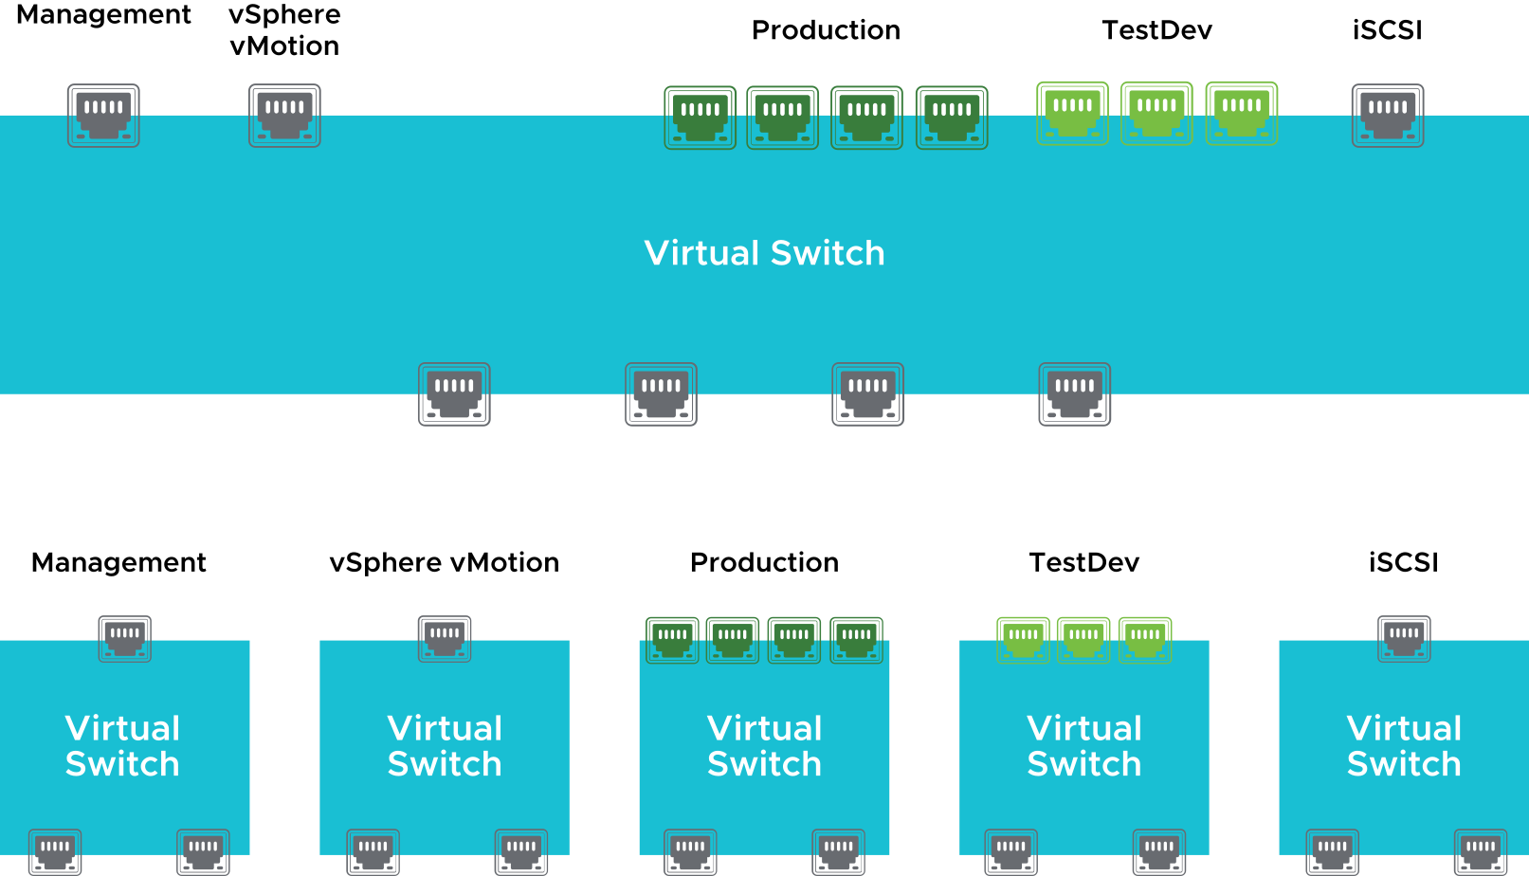
Virtual Switch Connection Examples
More than one network can coexist on the same virtual switch or on separate virtual switches.
Notes:
When you design your networking environment, you can team all your networks on a single virtual switch. Alternatively, you can opt for multiple virtual switches, each with a separate network. The decision partly depends on the layout of your physical networks. For example, you might not have enough network adapters to create a separate virtual switch for each network. Instead, you might place your network adapters in a single virtual switch and isolate the networks by using VLANs.
Because physical NICs are assigned at the virtual switch level, all ports and port groups that are defined for a particular switch share the same hardware.

Slide 10
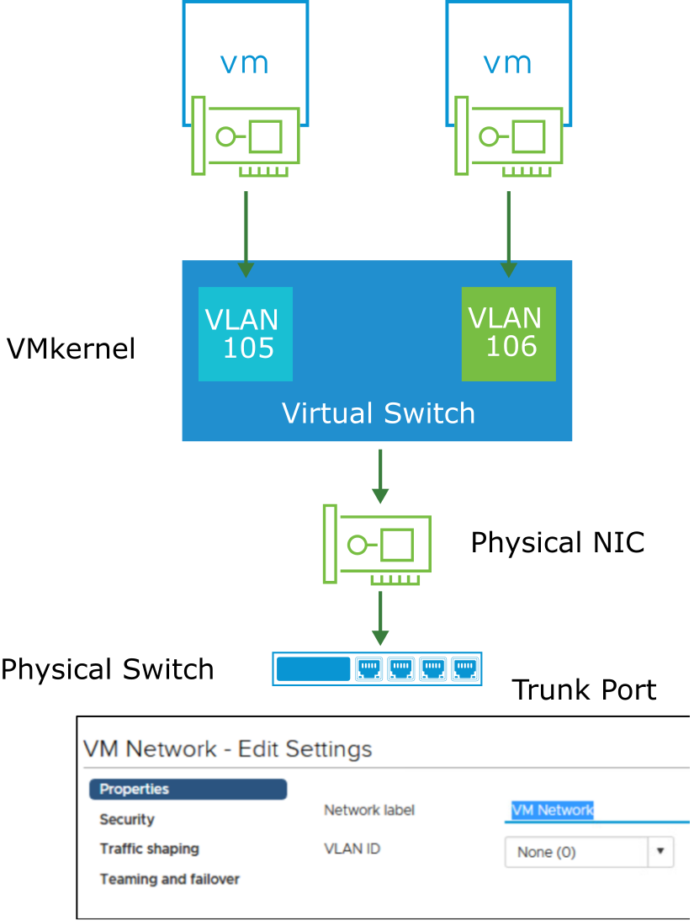
About VLANs
ESXi supports 802.1Q VLAN tagging.
Virtual switch tagging is one of the supported tagging policies:
Frames from a VM are tagged as they exit the virtual switch.
Tagged frames arriving at a virtual switch are untagged before they are sent to the destination VM.
The effect on performance is minimal.
ESXi provides VLAN support by assigning a VLAN ID to a port group.
Notes:
VLANs provide for logical groupings of switch ports. All virtual machines or ports in a VLAN communicate as if they are on the same physical LAN segment. A VLAN is a software-configured broadcast domain. Using a VLAN provides the following benefits:
Creation of logical networks that are not based on the physical topology
Improved performance by confining broadcast traffic to a subset of ports on a switch
Cost savings by partitioning the network without the overhead of deploying new routers
VLANs can be configured at the port group level. The ESXi host provides VLAN support through virtual switch tagging, which is provided by giving a port group a VLAN ID. By default, a VLAN ID is optional. The VMkernel takes care of all tagging and untagging as the packets pass through the virtual switch.
The port on a physical switch to which an ESXi host is connected must be defined as a static trunk port. A trunk port is a port on a physical Ethernet switch that is configured to send and receive packets tagged with a VLAN ID. No VLAN configuration is required in the VM. In fact, the VM does not know that it is connected to a VLAN.
For more information about how VLANs are implemented, see VMware knowledge base article 1003806 at http://kb.vmware.com/kb/1003806.

Slide 11
Types of Virtual Switches
A virtual network supports standard and distributed switches. Both switch types are elastic: Ports are created and removed automatically.
Standard switch:
Virtual switch that is configured for a single host.
Distributed switch:
Virtual switch that is configured for an entire data center.
Up to 2,000 hosts can be attached to the same distributed switch.
The configuration is consistent across all attached hosts.
Hosts must either have an Enterprise Plus license or belong to a vSAN cluster.

Slide 12
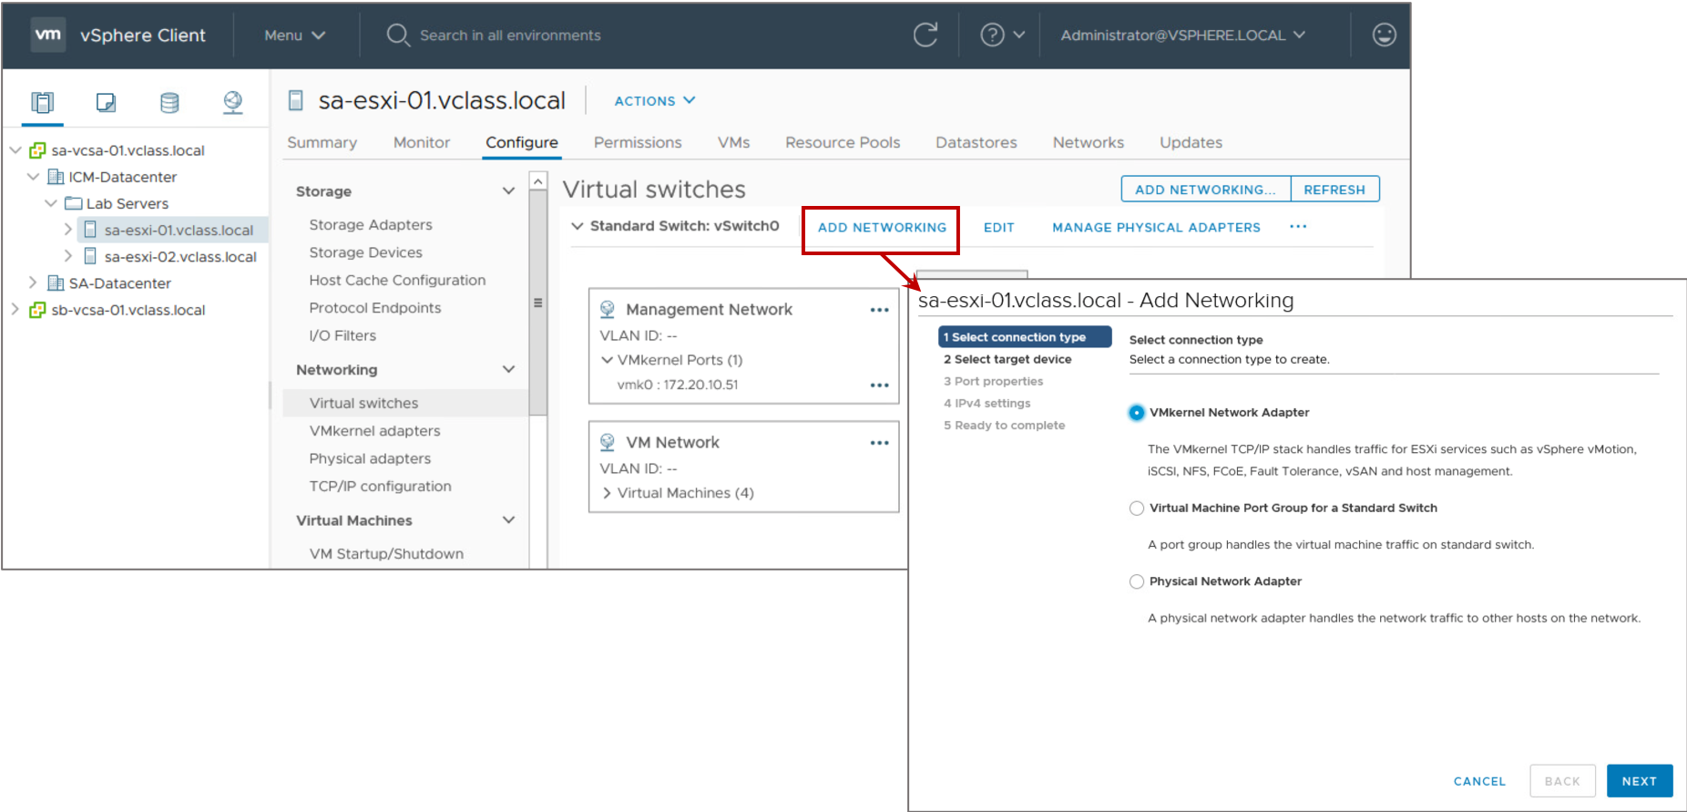
Adding ESXi Networking
You can add new standard switches to an ESXi host or configure existing ones using the vSphere Client or VMware Host Client.

Slide 13
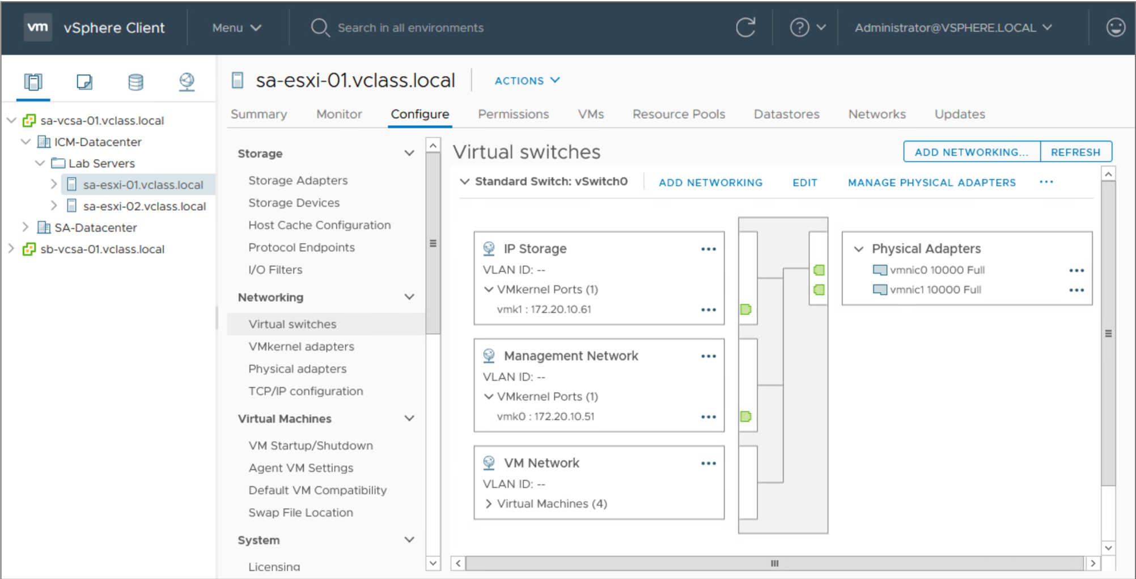
Viewing the Configuration of Standard Switches
In the vSphere Client, you can view a host’s standard switch configuration by selecting Virtual Switches on the Configure tab.
Notes:
The slide shows the standard switch vSwitch0 on the sa-esxi-01.vclass.local ESXi host. By default, the ESXi installation creates a virtual machine port group named VM Network and a VMkernel port named Management Network. You can create additional port groups such as the Production port group, which you can use for the production virtual machine network.
For performance and security, you should remove the VM Network virtual machine port group and keep VM networks and management networks separated.

Slide 14
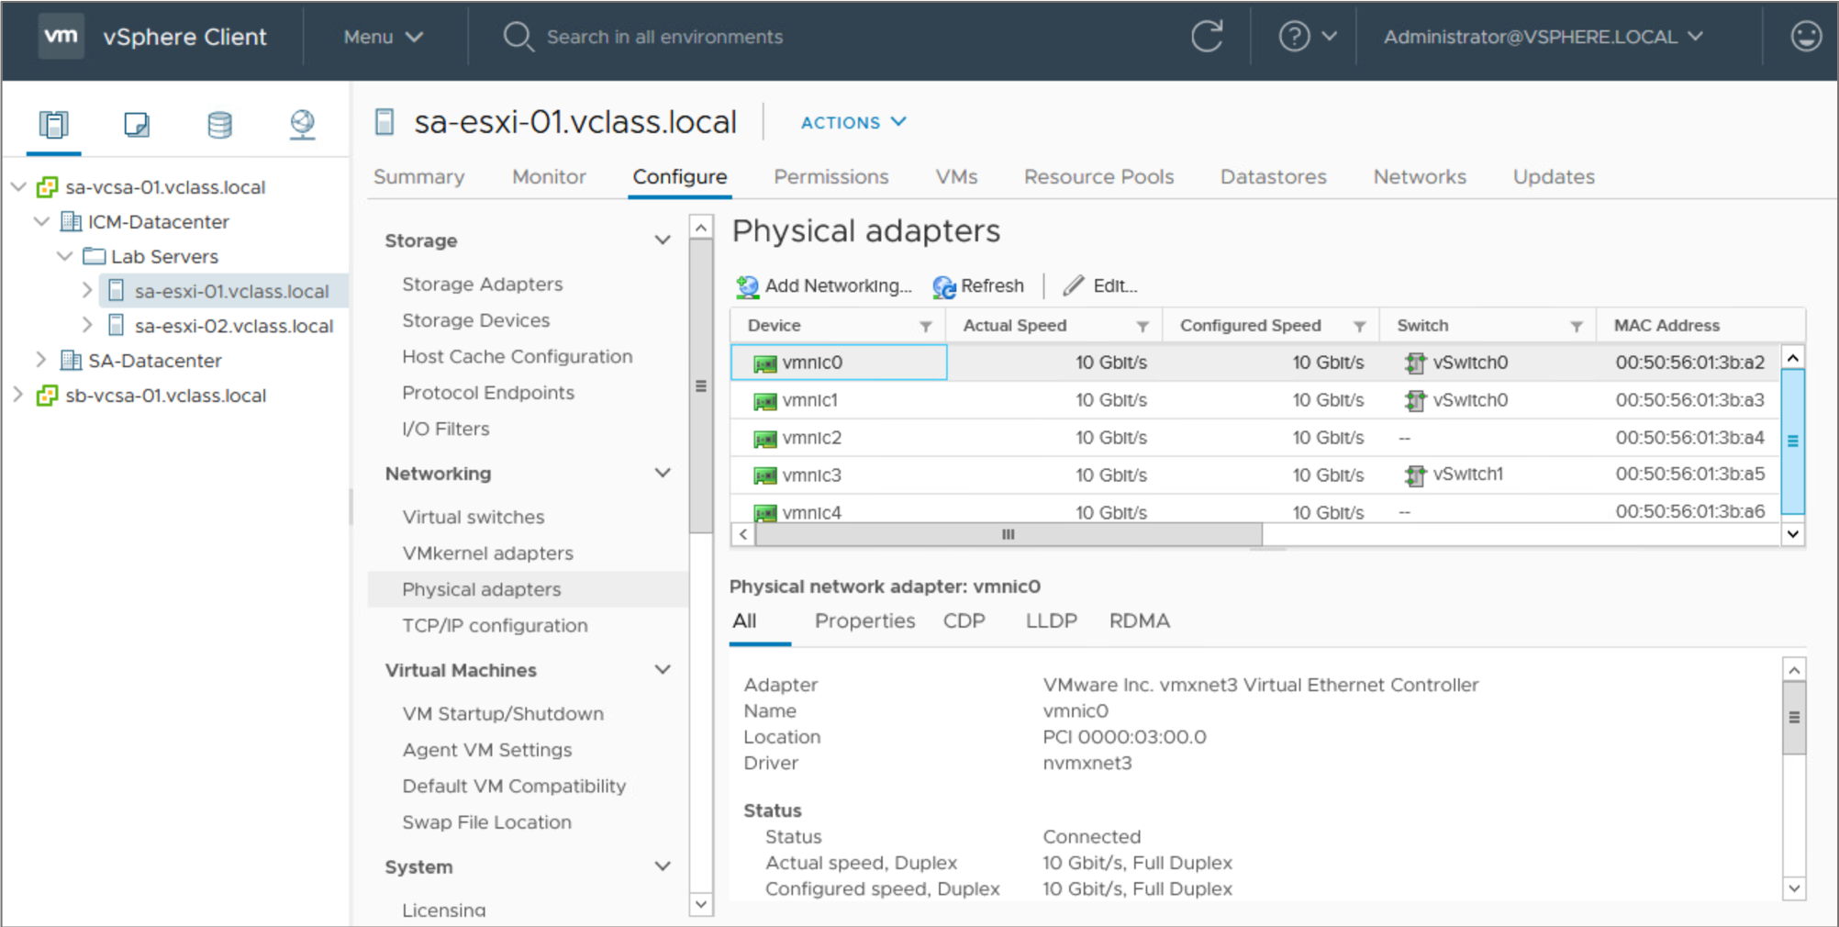
Network Adapter Properties
The Physical adapters pane shows adapter details such as speed, duplex, and MAC address settings.
Although the speed and duplex settings are configurable, the best practice is to leave the settings at autonegotiate.
Notes:
You can change the connection speed and duplex of a physical adapter to transfer data in compliance with the traffic rate.
If the physical adapter supports SR-IOV, you can enable it and configure the number of virtual functions to use for virtual machine networking.

Slide 15
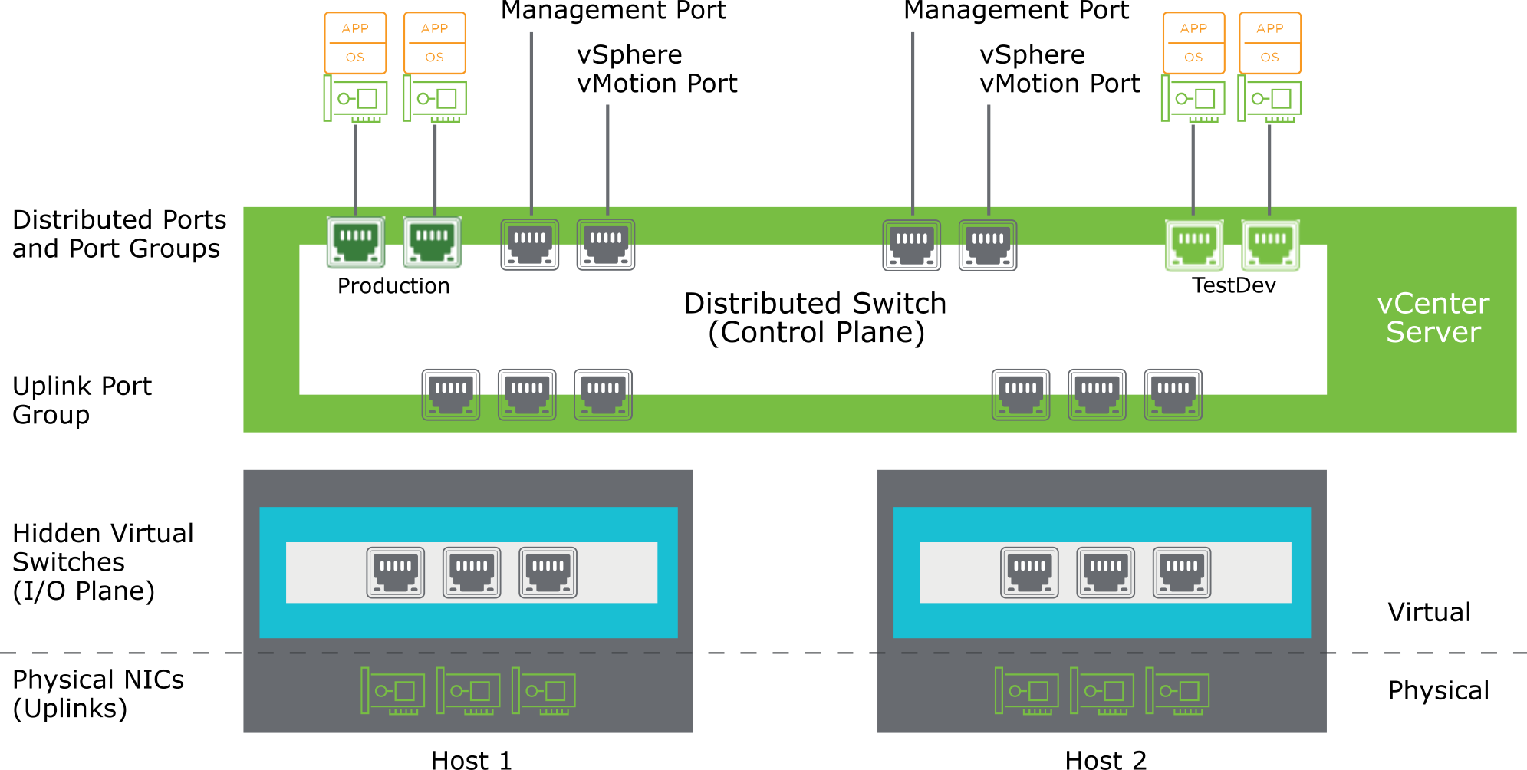
Distributed Switch Architecture
Notes:
vCenter Server owns the configuration of the distributed switch. The configuration is consistent across all hosts that use the distributed switch.

Slide 16
Standard and Distributed Switches: Shared Features
Standard and distributed switches have several features in common.
Feature | Standard Switch | Distributed Switch
Layer 2 switch | Yes | Yes
VLAN segmentation (802.1Q tagging) | Yes | Yes
IPv6 support | Yes | Yes
NIC teaming | Yes | Yes
Outbound traffic shaping | Yes | Yes
Cicso Discovery Protocol (CDP) | Yes | Yes

Slide 17
Additional Features of Distributed Switches
Distributed switches include several features that are not part of standard switches.
Feature | Standard Switch | Distributed Switch
Inbound traffic shaping | No | Yes
VM network port block | No | Yes
Private VLANs | No | Yes
Load-based teaming | No | Yes
Data center level management | No | Yes
vSphere vMotion migration of virtual networking state | No | Yes
Per-port policy settings | No | Yes
Port state monitoring of network statistics | No | Yes
NetFlow | No | Yes
Port mirroring | No | Yes
Access to NSX-T port groups | No | Yes
Link Layer Discovery Protocol (LLDP) | No | Yes
Notes:
During a vSphere vMotion migration, a distributed switch tracks the virtual networking state (for example, counters and port statistics) as the virtual machine moves from host to host. The tracking provides a consistent view of a virtual network interface, regardless of the virtual machine location or vSphere vMotion migration history. Tracking simplifies network monitoring and troubleshooting activities where vSphere vMotion is used to migrate virtual machines between hosts.

Slide 18
Lab 11: Using Standard Switches
Create a standard switch and a port group for virtual machines:
View the Standard Switch Configuration
Create a Standard Switch with a Virtual Machine Port Group
Attach Virtual Machines to the Virtual Machine Port Group

Slide 19
Review of Learner Objectives
After completing this lesson, you should be able to meet the following objectives:
Identify virtual switch connection types
Configure and view standard switch configurations
Distinguish between the features of standard and distributed switches

Slide 20
Lesson 2: Configuring Standard Switch Policies

Slide 21
Learner Objectives
After completing this lesson, you should be able to meet the following objectives:
Explain how to set the security policies for a standard switch port group
Explain how to set the traffic shaping policies for a standard switch port group
Explain how to set the NIC teaming and failover policies for a standard switch port group

Slide 22
Network Switch and Port Policies
Policies that are set at the standard switch level apply to all port groups on the standard switch by default.
Available network policies:
Security
Traffic shaping
NIC teaming and failover
Policy levels:
Standard switch level: Default policies for all the ports on the standard switch.
Port group level: Effective policies defined at this level override the default policies that are set at the standard switch level.
Notes:
Networking security policy provides protection against MAC address impersonation and unwanted port scanning.
Traffic shaping is useful when you want to limit the amount of traffic to a VM or a group of VMs.
Use the teaming and failover policy to determine the following information:
How the network traffic of VMs and VMkernel adapters that are connected to the switch is distributed between physical adapters
How the traffic should be rerouted if an adapter fails.

Slide 23
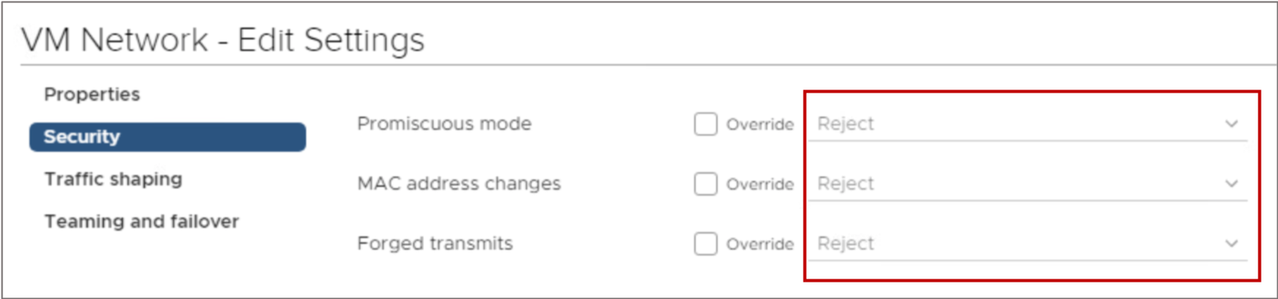
Configuring Security Policies
As an administrator, you can define security policies at both the standard switch level and the port group level:
Promiscuous mode: You can allow a virtual switch or port group to forward all traffic regardless of the destination.
MAC address changes: You can accept or reject inbound traffic when the MAC address is altered by the guest.
Forged transmits: You can accept or reject outbound traffic when the MAC address is altered by the guest.
Notes:
The network security policy contains the following exceptions:
Promiscuous mode: Promiscuous mode allows a virtual switch or port group to forward all traffic regardless of their destinations. The default is Reject.
MAC address changes: The default is Reject. If this option is set to Reject and the guest attempts to change the MAC address assigned to the virtual NIC, it stops receiving frames.
Forged transmits: A frame’s source address field might be altered by the guest and contain a MAC address other than the assigned virtual NIC MAC address. You can set the Forged Transmits parameter to accept or reject such frames. The default is Reject.
In vSphere 7, these security settings are set to Reject by default.
In general, these policies give you the option of disallowing certain behaviors that might compromise security. For example, a hacker might use a promiscuous mode device to capture network traffic for unscrupulous activities. Or, someone might impersonate a node and gain unauthorized access by spoofing its MAC address.
Set Promiscuous mode to Accept to use an application in a VM that analyzes or sniffs packets, such as a network-based intrusion detection system.
Keep the MAC address changes and Forged transmits set to Reject to help protect against attacks launched by a rogue guest operating system.
Set MAC address changes and Forged transmits to Accept if your applications change the mapped MAC address, as do some guest operating system-based firewalls.

Slide 24
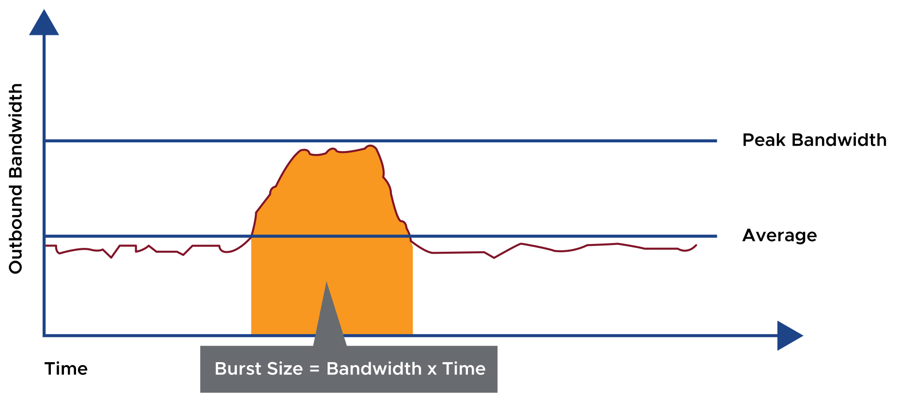
Traffic-Shaping Policies
Network traffic shaping is a mechanism for limiting a virtual machine’s consumption of available network bandwidth.
Average rate, peak rate, and burst size are configurable.
Notes:
A virtual machine’s network bandwidth can be controlled by enabling the network traffic shaper. The network traffic shaper, when used on a standard switch, shapes only outbound network traffic. To control inbound traffic, use a load-balancing system or turn on rate-limiting features on your physical router.

Slide 25
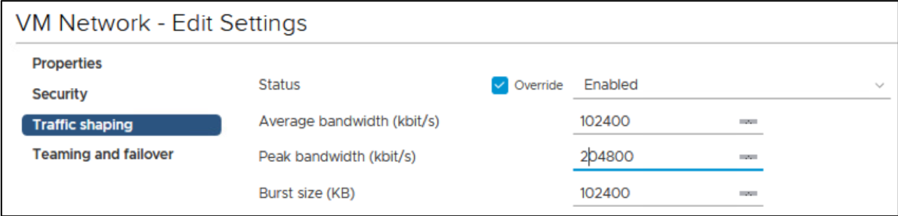
Configuring Traffic Shaping
A traffic-shaping policy is defined by average bandwidth, peak bandwidth, and burst size. You can establish a traffic-shaping policy for each port group and each distributed port or distributed port group:
Traffic shaping is disabled by default.
Parameters apply to each virtual NIC in the standard switch.
On a standard switch, traffic shaping controls only outbound traffic, that is, traffic traveling from the VMs to the virtual switch and out onto the physical network.
Notes:
The ESXi host shapes only outbound traffic by establishing parameters for the following traffic characteristics:
Average bandwidth (Kbps): Establishes the number of kilobits per second to allow across a port, averaged over time. The average bandwidth is the allowed average load.
Peak bandwidth (Kbps): The maximum number of kilobits per second to allow across a port when it is sending a burst of traffic. This number tops the bandwidth that is used by a port whenever the port is using the burst bonus that is configured using the Burst size parameter.
Burst size (KB): The maximum number of kilobytes to allow in a burst. If this parameter is set, a port might gain a burst bonus if it does not use all its allocated bandwidth. Whenever the port needs more bandwidth than specified in the Average bandwidth field, the port might be allowed to temporarily transmit data at a faster speed if a burst bonus is available. This parameter tops the number of kilobytes that have accumulated in the burst bonus and so transfers at a faster speed.
Network traffic shaping is off by default.
Although you can establish a traffic-shaping policy at either the virtual switch level or the port group level, settings at the port group level override settings at the virtual switch level.

Slide 26
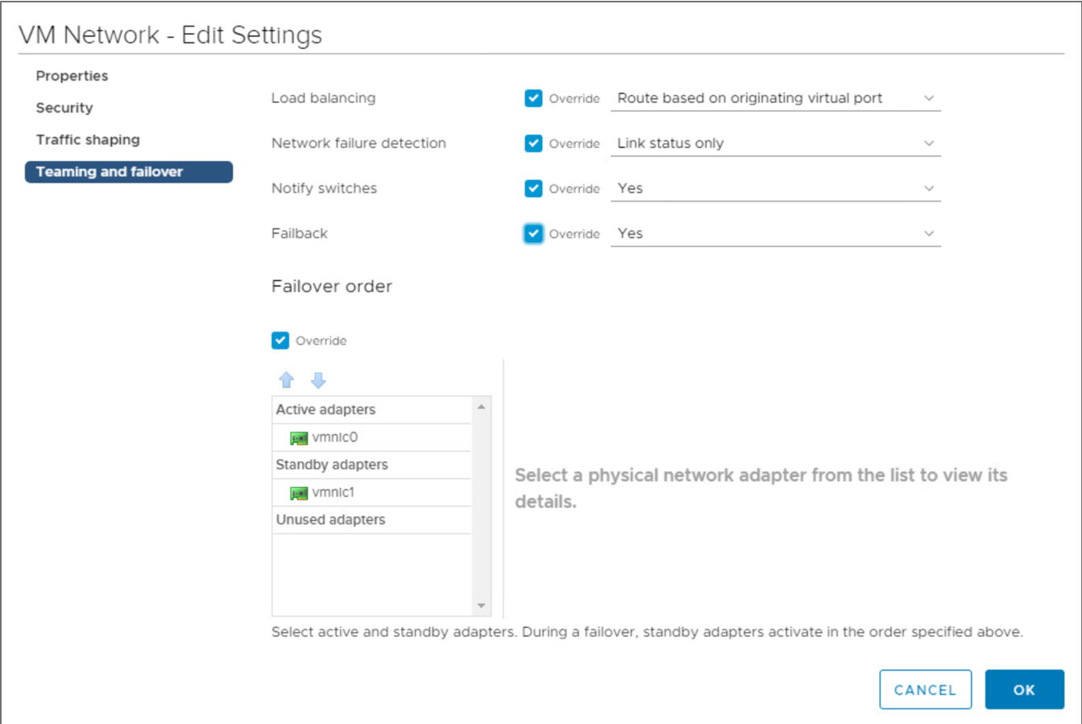
NIC Teaming and Failover Policies
With NIC teaming, you can increase the network capacity of a virtual switch by including two or more physical NICs in a team.
Notes:
NIC teaming increases the network bandwidth of the switch and provides redundancy. To determine how the traffic is rerouted when an adapter fails, you include physical NICs in a failover order.
To determine how the virtual switch distributes the network traffic between the physical NICs in a team, you select load-balancing algorithms depending on the needs and capabilities of your environment:
Load-balancing policy: This policy determines how network traffic is distributed between the network adapters in a NIC team. Virtual switches load balance only the outgoing traffic. Incoming traffic is controlled by the load-balancing policy on the physical switch.
Failback policy: By default, a failback policy is enabled on a NIC team. If a failed physical NIC returns online, the virtual switch sets the NIC back to active by replacing the standby NIC that took over its slot.
If the physical NIC that stands first in the failover order experiences intermittent failures, the failback policy might lead to frequent changes in the NIC that is used. The physical switch sees frequent changes in MAC addresses, and the physical switch port might not accept traffic immediately when an adapter comes online. To minimize such delays, you might consider changing the following settings on the physical switch.
Notify switches policy: With this policy, you can determine how the ESXi host communicates failover events. When a physical NIC connects to the virtual switch or when traffic is rerouted to a different physical NIC in the team, the virtual switch sends notifications over the network to update the lookup tables on physical switches. Notifying the physical switch offers the lowest latency when a failover or a migration with vSphere vMotion occurs.
Default NIC teaming and failover policies are set for the entire standard switch. These default settings can be overridden at the port group level. The policies show what is inherited from the settings at the switch level.

Slide 27
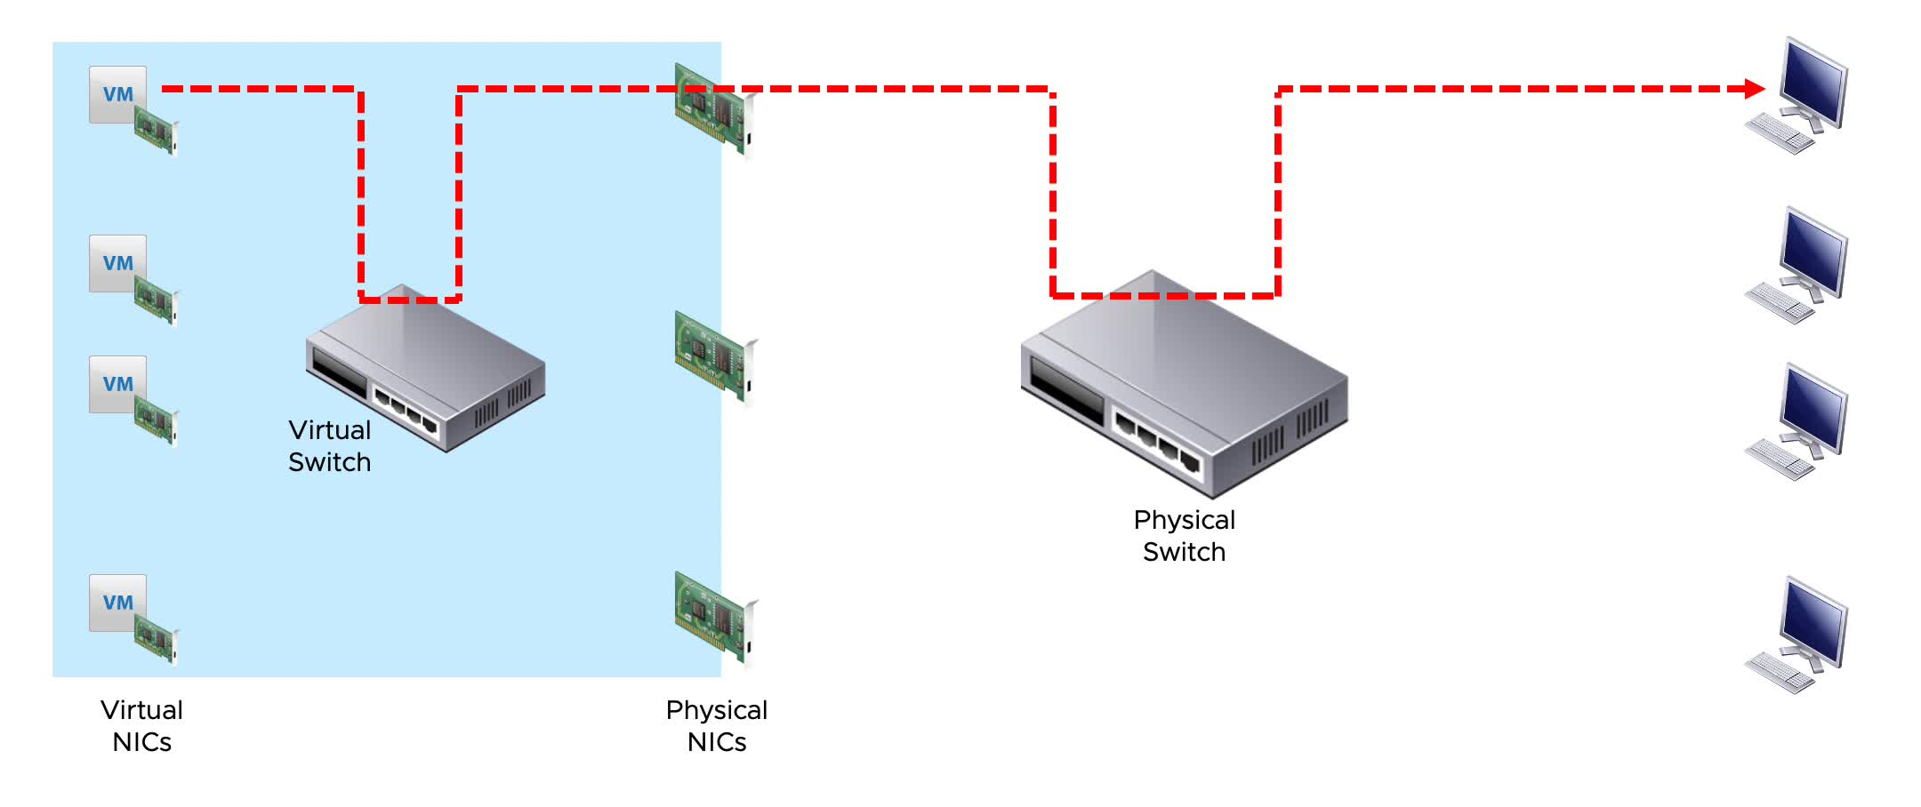
Load-Balancing Method: Originating Virtual Port ID
With the load-balancing method that is based on the originating virtual port ID, a virtual machine’s outbound traffic is mapped to a specific physical NIC.
Notes:
To play the animation, go to https://vmware.bravais.com/s/7jEkuYyY0f7OxeWbmmvZ.
The load-balancing method that uses the originating virtual port ID is simple and fast and does not require the VMkernel to examine the frame for the necessary information. The NIC is determined by the ID of the virtual port to which the VM is connected. With this method, no single-NIC VM gets more bandwidth than can be provided by a single physical adapter.
This method has advantages:
Traffic is evenly distributed if the number of virtual NICs is greater than the number of physical NICs in the team.
Resource consumption is low because, in most cases, the virtual switch calculates uplinks for the VM only once.
No changes on the physical switch are required.
This method also has disadvantages:
The virtual switch is not aware of the traffic load on the uplinks, and it does not load balance the traffic to uplinks that are less used.
The bandwidth that is available to a VM is limited to the speed of the uplink that is associated with the relevant port ID, unless the VM has more than one virtual NIC.

Slide 28
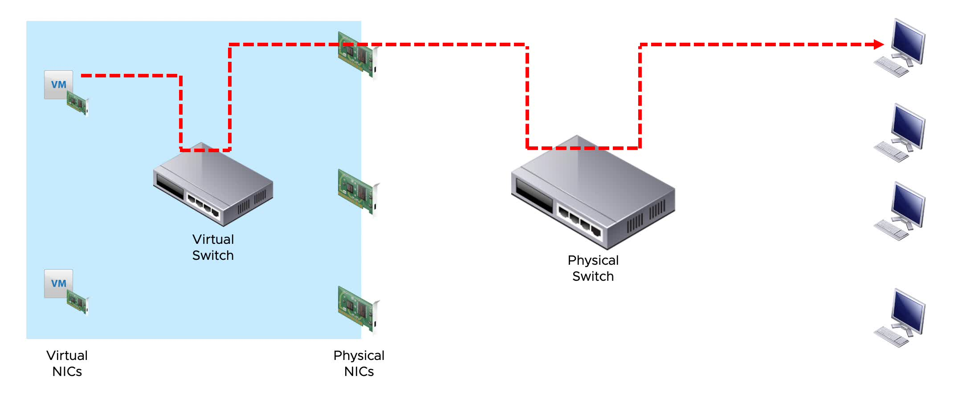
Load-Balancing Method: Source MAC Hash
For the load-balancing method based on source MAC hash, each virtual machine’s outbound traffic is mapped to a specific physical NIC that is based on the virtual NIC’s MAC address.
Notes:
To play the animation, go to https://vmware.bravais.com/s/MmjsUVkaURaNJzMnsao2.
The load-balancing method based on source MAC hash has low overhead and is compatible with all switches, but it might not spread traffic evenly across all the physical NICs. In addition, no single-NIC virtual machine gets more bandwidth than a single physical adapter can provide.
This method has advantages:
VMs use the same uplink because the MAC address is static. Powering a VM on or off does not change the uplink that the VM uses.
No changes on the physical switch are required.
This method has disadvantages:
The bandwidth that is available to a VM is limited to the speed of the uplink that is associated with the relevant port ID, unless the VM uses multiple source MAC addresses.
Resource consumption is higher than with a route based on the originating virtual port because the virtual switch calculates an uplink for every packet.
The virtual switch is not aware of the load of the uplinks, so uplinks might become overloaded.

Slide 29

Load-Balancing Method: Source and Destination IP Hash
With the IP-based load-balancing method, a NIC for each outbound packet is selected based on its source and destination IP addresses.
Notes:
To play the animation, go to https://vmware.bravais.com/s/55sfU1JyzGzuBGWETPu9.
The IP-based method requires 802.3ad link aggregation support or EtherChannel on the switch. The Link Aggregation Control Protocol is a method to control the bundling of several physical ports to form a single logical channel. LACP is part of the IEEE 802.3ad specification.
EtherChannel is a port trunking technology that is used primarily on Cisco switches. With this technology, you can group several physical Ethernet links to create one logical Ethernet link for providing fault tolerance and high-speed links between switches, routers, and servers.
With this method, a single-NIC virtual machine might use the bandwidth of multiple physical adapters.
The IP-based load-balancing method only affects outbound traffic. For example, a VM might choose a particular NIC to communicate with a particular destination VM. The return traffic might not arrive on the same NIC as the outbound traffic. The return traffic might arrive on another NIC in the same NIC team.
This method has advantages:
The load is more evenly distributed compared to the route based on the originating virtual port and the route based on source MAC hash because the virtual switch calculates the uplink for every packet.
VMs that communicate with multiple IP addresses have a potentially higher throughput.
This method has disadvantages:
Resource consumption is the highest compared to the other load-balancing algorithms.
The virtual switch is not aware of the actual load of the uplinks.
Changes on the physical network are required.
The method is complex to troubleshoot.

Slide 30
Detecting and Handling Network Failure
The VMkernel can use link status or beaconing, or both, to detect a network failure.
Network failure is detected by the VMkernel, which monitors the link state and performs beacon probing.
The VMkernel notifies physical switches of changes in the physical location of a MAC address.
Failover is implemented by the VMkernel based on configurable parameters:
Failback: How the physical adapter is returned to active duty after recovering from failure.
Load-balancing option: Use explicit failover order. Always use the vmnic uplink at the top of the active adapter list.
Notes:
Monitoring the link status that is provided by the network adapter detects failures such as cable pulls and physical switch power failures. This monitoring does not detect configuration errors, such as a physical switch port being blocked by the Spanning Tree Protocol or misconfigured VLAN membership. This method cannot detect upstream, nondirectly connected physical switch or cable failures.
Beaconing introduces a 62-byte packet load approximately every 1 second per physical NIC. When beaconing is activated, the VMkernel sends out and listens for probe packets on all NICs that are configured as part of the team. This technique can detect failures that link-status monitoring alone cannot. Consult your switch manufacturer to verify the support of beaconing in your environment. For information on beacon probing, see VMware knowledge base article 1005577 at http://kb.vmware.com/kb/1005577.
A physical switch can be notified by the VMkernel whenever a virtual NIC is connected to a virtual switch. A physical switch can also be notified whenever a failover event causes a virtual NIC’s traffic to be routed over a different physical NIC. The notification is sent over the network to update the lookup tables on physical switches. In most cases, this notification process is beneficial because, without it, VMs experience greater latency after failovers and vSphere vMotion operation. Do not set this option when the VMs connected to the port group are running unicast-mode Microsoft Network Load Balancing (NLB). NLB in multicast mode is unaffected. For more information about the NLB issue, see VMware knowledge base article 1556 at http://kb.vmware.com/kb/1556.
When using explicit failover order, always use the highest order uplink from the list of active adapters that pass failover-detection criteria.
The failback option determines how a physical adapter is returned to active duty after recovering from a failure:
If Failback is set to Yes, the failed adapter is returned to active duty immediately on recovery, displacing the standby adapter that took its place at the time of failure.
If Failback is set to No, a failed adapter is left inactive even after recovery, until another currently active adapter fails, requiring its replacement.

Slide 31
Physical Network Considerations
Your virtual networking environment relies on the physical network infrastructure. As a vSphere administrator, you should discuss your vSphere networking needs with your network administration team.
The following issues are topics for discussion:
Number of physical switches
Network bandwidth required
Physical switch configuration support for 802.3ad, for NIC teaming
Physical switch configuration support for 802.1Q, for VLAN tagging
Physical switch configuration support for Link Aggregation Control Protocol (LACP)
Network port security
Link Layer Discovery Protocol (LLDP) and Cisco Discovery Protocol (CDP) and their operation modes, such as listen, broadcast, listen and broadcast, and disabled

Slide 32
Review of Learner Objectives
After completing this lesson, you should be able to meet the following objectives:
Explain how to set the security policies for a standard switch port group
Explain how to set the traffic shaping policies for a standard switch port group
Explain how to set the NIC teaming and failover policies for a standard switch port group

Slide 33
Virtual Beans: Networking Requirements
As a Virtual Beans administrator, you have a few decisions to make about your network infrastructure.
As you plan your network, you consider these key takeaways about vSphere networking:
You must create port groups for the VLANs that you want to use in your vSphere environment.
You can use NIC teaming in the virtual switch to avoid a single point of failure.
You can separate infrastructure service traffic from your application traffic by putting each traffic type on its own VLAN.
Segmenting traffic can improve performance and enhance security by limiting network access to a specific traffic type.
You should research the benefits of using distributed switches in your environment. Distributed switches have additional features over standard switches.

Slide 34
Key Points
Virtual switches can have the following connection types: VM port group, VMkernel port, and physical uplinks.
A standard switch is a virtual switch configuration for a single host.
Network policies set at the standard switch level can be overridden at the port group level.
A distributed switch provides centralized management and monitoring for the networking configuration of all ESXi hosts that are associated with the switch.
Questions?

